Slide 1
Identify input devices and their uses, e.g. keyboard, numeric keypad, pointing devices (such as mouse, touchpad, tracker ball), remote control, joystick/driving wheel, touch screen, scanners, digital cameras, microphone, sensors (general), temperature sensor, pressure sensor, light sensor, graphics tablet, video camera, web cam

Slide 2
Fill in the blanks
Input Devices allow data to be ____________ into a computer.
A mouse, touch pad and a tracker ball are know as _____________ devices.
A touch pad is built into the ____________. It is more difficult to use compared to a ___________.
A numeric key pad could be used at an ________ , _________ or ________________.
Remote control can be used at a ___________.
_______________ and _______________ can be used in a web conference.
Sensors read in ____________ signals. Computers read in ____________ signals. An ______ is required to convert the signal so that it can be understood by the computer.
ATM
Microphone
POS
Web Cam
Chip and Pin
Laptop
ADC
Pointing
input
Distance
Digital
Mouse
Analogue

Slide 3
 |  |  |  | 1 |  |  |  |  |  |  |  |  |  |  |  |  | 2
 |  | 1
 |  | 2 |  |  |  |  |  |  |  |  |  |  |  | 6
 | 3
 |  |  | 3
 |  |  | 4
 |  |  |  |  |  | 5
4
Down
Pointing Device
Used from a distance
Used in Computer games/simulators
Can be used to create copies
Type in numerical data
6) Used in web conference
Across
Part of a laptop (Pointing device)
Measures real world properties
Used to input sound
Used by users with restricted wrist movement.
Sensors record in this signal

Slide 4
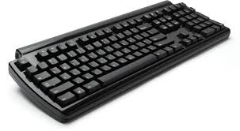

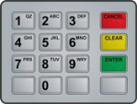


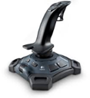

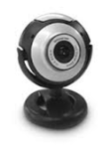

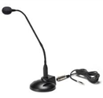
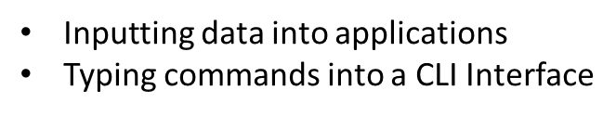
Matching Input Device and their Use

Slide 5
Questions
1) Describe three different types of input devices you use?
2) Describe three different types of sensors and their use?
3) Why can computers not read data from sensors?
4) What is required for a computer to read data from a sensor?

